Slide 1
Pre-assessment Questions
  1. Predict the output of the expression, 16 % 3?
    a. 5
    b. 0
    c. 1
    d. 4
  2. What is the default value of the float data type?
    a. 0.0
    b. 0
    c. 1.0
    d. 1

Slide 2
Pre-assessment Questions (Contd.)
  3. Consider the statements:
  Statement A: The name of a variable can begin with a digit.
  Statement B: The name of a variable can contain white spaces.
  Identify the correct option.
    a. Statement A is true and statement B is false.
    b. Statement A is false and statement B is true.
    c. Both, statements, A and B, are true.
    d. Both, statements, A and B, are false.

Slide 3
Pre-assessment Questions (Contd.)
  4. _______variables are the local variables that are accessed by the function in which the variables are declared.
  a. Static
  b. Automatic
  c. Instance
  d. Class.
  _______ literals are enclosed in single quotes.
    a. String
    b. Character
    c. Boolean
    d. Integer

Slide 4
Solutions to Pre-assessment Questions
  c. 1
  a. 0.0
  d. Both, statements A and B, are false
  a. Static
  b. Character

Slide 5
Objectives
  In this lesson, you will learn about:
    Structure of a Java program
    Access specifiers and modifiers
    Creating a Java application

Slide 6
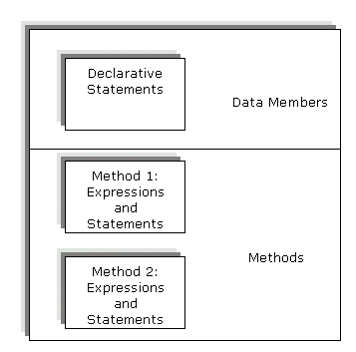
Structure of Java Application
  Creating Classes and Objects
    The components of a class consists of
      Data members (Attributes)
      Methods

Slide 7
Structure of Java Application (Contd.)
  Creating Classes in Java
    The statements written in a Java class must end with a semicolon, ;.
    class ClassName
    {
    //Declaration of data members
    //Declaration of methods
    }
  Double slash, //, are comment entries. Comments are ignored by compiler.

Slide 8
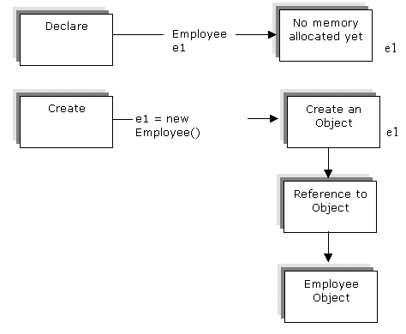
Structure of Java Application (Contd.)
  Creating Objects of Classes
    An object is an instance of a class having a unique identity.
    To create an object, you need to perform the following steps:
      Declaration
      Instantiation or creation

Slide 9
Structure of Java Application (Contd.)
  Accessing Data Members of a Class
    Assign values to data members of the object before using them.
    You can access the data members of a class outside the class by specifying the object name followed by the dot operator and the data member name.
      e1.employeeName="John";
      e2.emmployeeName="Andy";
      e1.employeeID=1;
      e2.employeeID=2;
      e1.employeeDesignation = “Manager”;
      e2.employeeDesignation = “Director”;

Slide 10
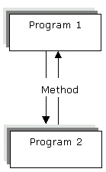
Structure of Java Application (Contd.)
  Adding Methods to a Class
    Accessing data members directly overrules the concept of encapsulation.
    Advantages of using methods in a Java program:
      Reusability
      Reducing Complexity
      Data Hiding

Slide 11
Structure of Java Application (Contd.)
    The syntax to define a method:
      void methodName()
      {
      // Method body.
      }

Slide 12
Structure of Java Application (Contd.)
  Declaring the main() Method:
    The syntax to declare the main()method:
      public static void main(String args[])
      {
      // Code for main() method
      }
    public: method can be accessed from any object in a Java program.
    static : associates the method with its class.
    void: signifies that the main() method returns no value.
  The main() method can be declared in any class but the name of the file and the class name in which the main() method is declared should be the same.
  The main() method accepts a single argument in the form of an array of elements of type String.

Slide 13
Structure of Java Application (Contd.)
  Following code snippet creates objects for four employees of an organization:
    Employee e1 =new Employee();
    Employee e2 =new Employee();
    Employee e3 =new Employee();
    Employee e4 =new Employee();

Slide 14
Structure of Java Application (Contd.)
  Defining Constructors
    A constructor is a method with the same name as the class name.
    A constructor of a class is automatically invoked every time an instance of a class is created.
  Characteristics of Constructors
    There is no return type for a constructor.
    A constructor returns the instance of the class instead of a value.
    A constructor is used to assign values to the data members of each object created from a class.

Slide 15
Access Specifiers and Modifiers
  Access Specifiers
    public
    private
    protected
    friendly
  The public access specifier
    Class members with public specifier can be accessed anywhere in the same class, package in which the class is created, or a package other than the one in which the class is declared.
    The public keyword is used to declare a member as public.
      public <data type> <variable name>;

Slide 16
Access Specifiers and Modifiers
  The private access specifier
    A data member of a class declared private is accessible at the class level only in which it is defined.
    The private keyword is used to declare a member as private.
      private float <variableName>; // Private data member of float //type
      private methodName(); // Private method
  The protected access specifier
    The variables and methods are accessible only to the subclasses of the class in which they are declared.
    The protected keyword is used to declare a member as protected.
      protected <data type> <name of the variable>;
  The friendly or package access specifier
    If you do not specify any access specifier, the scope of data members and methods is friendly.

Slide 17
Access Specifiers and Modifiers(Contd.)
  Types of Permitted Modifiers
    Modifiers determine or define how the data members and methods are used in other classes and objects.
      static
      final
      abstract
      native
      synchronized

Slide 18
Access Specifiers and Modifiers(Contd.)
      static
        Used to define class variables and methods that belong to a class and not to any particular instance of the class.
        Associates the data members with a class and not the objects of the class.
      final
        Indicates that the data member cannot be modified.
        Does not allow the class to be inherited.
        A final method cannot be modified in the subclass.
        All the methods and data members in a final class are implicitly final.
      abstract
        Used to declare classes that define common properties and behavior of other classes.
        An abstract class is used as a base class to derive specific classes of the same type.

Slide 19
Access Specifiers and Modifiers(Contd.)
      native
        Used only with methods.
        Inform the compiler that the method has been coded in a programming language other than Java, such as C or C++ .
        The native keyword with a method indicates that the method lies outside the Java Runtime Environment (JRE).
        public native void nativeMethod(var1, var2, . . .) ;
      synchronized
        controls the access to a block of code in a multithreaded programming environment.
        Java supports multithreaded programming and each thread defines a separate path of execution.

Slide 20
Compiling an Application
  Compiling an Application
    Save the code with a file name that is exactly the same as that of the class name, with a .java extension.
    The steps to compile the Java file:
      Open the command window.
      Set the PATH variable to the bin directory of the installation directory by using the following command at the command prompt:
      PATH=C:\j2sdk1.4.1_02\bin

Slide 21
Compiling an Application
    Change to the directory where you have saved the .java file. You can also give the complete path of the .java file while compiling it .
    Compile the application
    Execute the Bytecode.

Slide 22
Summary
  In this lesson, you learned:
  A class includes data members and methods. Methods can include expressions that evaluate to a value.
  Creating a class includes declaration of class members. Data members of same type can be declared in a single line.
  You can declare a class without data variables and methods.
  A class with only data members is of no practical use.
  You can interact directly with data members inside the class only.
  Object creation includes declaration of class object variable and assigning memory to object variable.
  You can access data members outside the class through class objects.
  A constructor is invoked on every creation of an object of a class type. The constructor can be used to initialize data members of newly created object.

Slide 23
Summary(Contd.)
  There are two types of constructors the default constructor and the overloaded constructor.
  A constructor returns no value and has the same name as the class itself.
  A Java application requires a main() method to start execution.
  The Java interpreter first of all looks for the main() method. The class name and the file name in which the main() method is declared are same.
  You can use access specifiers to restrict the access to class members by other classes.
  There are private, public, and protected access specifiers. Private access specifier gives the most restricted access among all the access specifiers.

Slide 24
Summary(Contd.)
  Class members with public specifier can be accessed anywhere in the same class, same package, or a different package.
  A modifier determines the use of the data members and methods in other classes and objects.
  The various modifiers available in Java are static, final, abstract, native, and synchronized .
  You must set the PATH variable of the operating system to the bin directory of the installation directory.
  You need to use the javac fileName.java command to compile the fileName.java file.
  You need to use the java fileName to execute the fileName.class file.

